Slide 1

APRIL 22, 2025
Online Grocery store Backend system
ZILIANG GUO

Slide 2





Design Rationale & Tools：
Backend Framework
Spring Boot
Built RESTful APIs for all core operations.
Database (MySQL)
Managed persistent data with relational integrity and transactional support.
External Integration
eBay API: Simulated real product listings to populate the store, adding realism to inventory and user interactions.
An online store backend supporting：
user management
product search
product viewing
cart update
order checkout
Notes:
My project is a backend system for an online grocery store. It supports basic e-commerce features such as managing users, items, carts, and orders. For the backend, I used Spring Boot, and for the database, I used MySQL. I also integrated a third-party API — eBay’s API — to fetch real product data, which made the project feel more realistic and closer to an actual production environment.

Slide 3
HTTP Method | Endpoint | Functionality
GET | /cart | Get all cart entries
GET | /cart/{user_id} | Get cart by user ID
POST | /cart/update | Update a cart item
GET | /item | Get all items
POST | /item/add | Add a new item
GET | /item/id/{id} | Get item by ID
GET | /item/search/{name} | Search item by name (case-insensitive)
PUT | /item/update/{id} | Update item by ID
GET | /order | Get all orders
GET | /order/{user_id} | Get orders by user ID
POST | /checkout/{user_id} | Checkout user's cart, generate order
DELETE | /order/delete/{order_id} | Delete an order by ID
GET | /user | Get all users
POST | /user/{id}/{name} | Create a new user
GET | /user/{id} | Get user by ID
DELETE | /user/{id} | Delete user by ID
Notes:
Since this is a backend system, this slide shows all the APIs I designed. I won’t walk through each one in detail, but what I do want to highlight is that they follow RESTful conventions and function well.

Slide 4
HTTP Method | Endpoint | Functionality
GET | /cart | Get all cart entries
GET | /cart/{user_id} | Get cart by user ID
POST | /cart/update | Update a cart item
GET | /item | Get all items
POST | /item/add | Add a new item
GET | /item/id/{id} | Get item by ID
GET | /item/search/{name} | Search item by name (case-insensitive)
PUT | /item/update/{id} | Update item by ID
GET | /order | Get all orders
GET | /order/{user_id} | Get orders by user ID
POST | /checkout/{user_id} | Checkout user's cart, generate order
DELETE | /order/delete/{order_id} | Delete an order by ID
GET | /user | Get all users
POST | /user/{id}/{name} | Create a new user
GET | /user/{id} | Get user by ID
DELETE | /user/{id} | Delete user by ID
Notes:
Let’s take the ‘order’ controller as an example — you can either view all orders or filter them by user ID. There’s also a checkout endpoint that creates an order summary. Of course you can also delete the order. Now, let’s actually try buying something from my grocery store!

Slide 5






Shopping List
Come shopping with me!
Flour
Milk
Syrup

Slide 6



design flowchart
1
Call ebay api to fetch data
client / frontend
2
Inject data
when starting the backend server
send Http Requests
4
UserServices
Restful Controllers
ItemServices
Mysql
3
CartServices
OrderServices
database
backend based on springboot
Notes:
After the walkthrough we just did, you probably now have a clearer picture of how the backend works. So here’s a more structured view of the overall system.
The first step is to automatically inject initial data into the MySQL database. Then, the client sends requests to the backend, and the backend processes those requests accordingly.
Now, this leads us to the first key concept in my project...

Slide 7
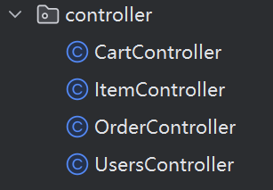
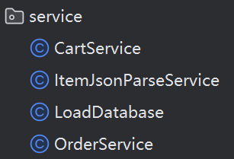
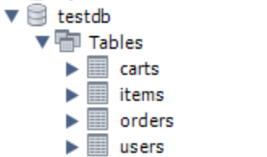
Key OOD Concepts in My Project
1
MVC design pattern
Call ebay api to fetch data
client / frontend
Inject data
when starting the backend server
2
send Http Requests
3
4
data access
decouple
repository
model
MySQL
backend based on springboot
Notes:
The first key object-oriented design principle in my project is the MVC pattern. I decoupled the controller from the service layer, so the controller only handles HTTP requests, while all the business logic is delegated to the service. The service then interacts with the database, which is represented by the model. Although my project doesn’t include a frontend at this stage, the current structure makes it easy to integrate a separate view in the future.

Slide 8
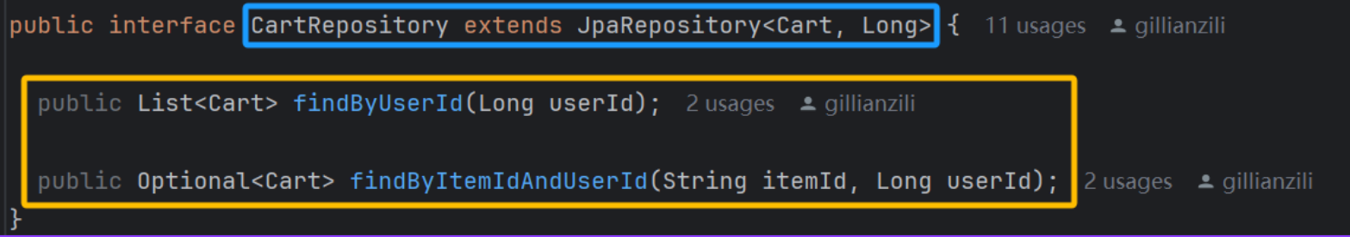
Key OOD Concepts in My Project
Abstraction
CartRepo defines required operations without implementation details.
CartRepo extends JpaRepository, inheriting CRUD operations.
Custom methods like findByUserId follow JPA conventions, with runtime method generation via interface-based design.
Inheritance
Polymorphism
Notes:
Here are some other basic Object-Oriented Design principles used in my project.
These three lines of code define a CartRepository interface that extends JpaRepository, which is a built-in interface provided by Spring Boot to simplify database operations.
Even though it looks simple, it actually demonstrates three important OOD concepts: abstraction, inheritance, and polymorphism."
Let me break it down a little bit

Slide 9
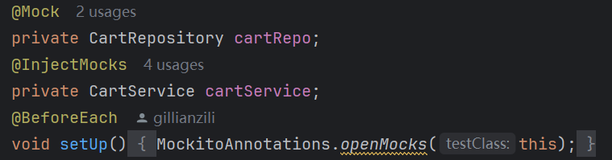
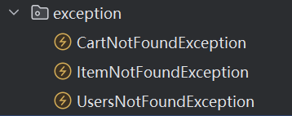
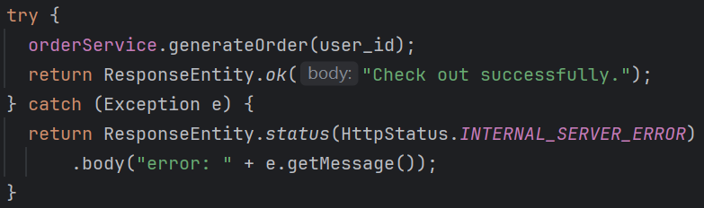
Other highlights in My Project
Mock Testing
Better error handling
Try-Catch Blocks
Notes:
They help isolate and manage different error types more effectively in large applications.. It’s technically okay to skip the try-catch block because we can see the error in the terminal, but the error messages are usually hard to read. By using try-catch, I can prevent the backend from crashing and return more readable, meaningful error messages.

Slide 10

limitations：
1
The project currently lacks a frontend interface
2
Stock modified design
Checkout
UpdateCart
Check stock availability at checkout.
Lock product rows during the check.
Use a transaction for all updates.
Roll back if any step fails.
deduct the storage
Mysql
Mysql
current
optimized
Notes:
In my current design, the item stock in the database is deducted as soon as a user adds something to their cart. This is convenient, but it puts all the risk on the store. Think about it — if users keep adding items to their cart without ever checking out, it becomes impossible for the store to restock effectively. A more realistic approach would be to update the inventory only at checkout. But that leads to deeper challenges: it requires a stronger understanding of MySQL, because we have to handle potential data consistency issues, deal with concurrency, and possibly implement locking mechanisms for multi-threaded access.

Slide 11
What I learned：
1
How to design and build a complete backend project from scratch
Gained hands-on experience with various tools, including RESTful APIs, Spring Boot, and database integration.
Developed the habit of iterating on design decisions and reflecting on trade-offs in real-world scenarios.（H2->MySQL)
Improved testing mindset — writing and testing in small chunks.
2
3
4
Notes:
This project gave me a full-cycle experience of how to design and build a backend system from scratch. I gained hands-on experience working with RESTful APIs, Spring Boot, and database integration — starting with H2 for simplicity, then switching to MySQL for a more realistic setup.
Throughout the process, I developed the habit of constantly iterating on design decisions and thinking critically about trade-offs in real-world scenarios.
I also improved my testing mindset — learning to build and test in small, manageable chunks instead of waiting until the end. This helped me catch bugs early and write more reliable code.

Slide 12
Citations：
https://blog.postman.com/rest-api-examples/
https://spring.io/projects/spring-boot
https://medium.com/@paulboeck/persisting-data-to-mysql-with-spring-data-jpa-28a296b4adb7
https://github.com/spring-projects/spring-petclinic
https://www.w3schools.com/MySQL/default.asp
https://www.mysqltutorial.org/
https://developer.ebay.com/develop/get-started

Slide 13

Thanks

